Slide 1
$\text{Δ}\text{E}2≠ℏω$_{r}
$\text{Δ}\text{E}\text{1}=ℏω$_{r}
E
E
1
𝝙E
1,1
0
1,0
Control parameter
0,1
2
1
$ℏω$_{r}
0
0,0

Slide 2
E
E
1,1
1,1
1,0
1,0
0,1
0,1
$$\text{Δ}\text{E}≠$$
$ℏω$_{r1}
$ℏω$_{r2}
$$\text{Δ}\text{E}=$$
0,0
0,0

Slide 3
E
E
1,1
1,1
1,0
1,0
0,1
0,1
$$\text{Δ}\text{E}≠$$
$ℏω$₀
$ℏω$₀
$$\text{Δ}\text{E}=$$
0,0
0,0
1
2

Slide 4
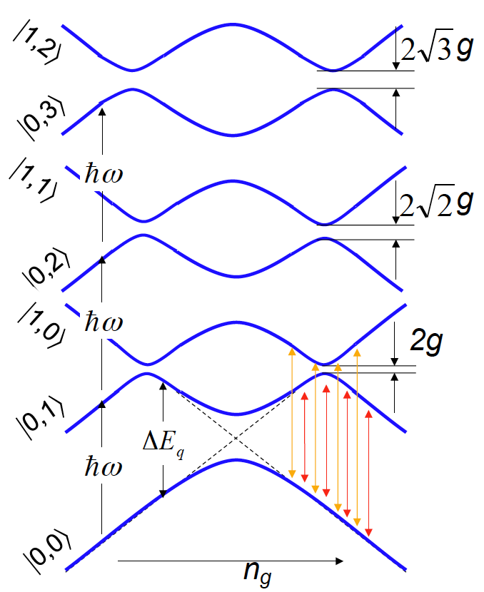
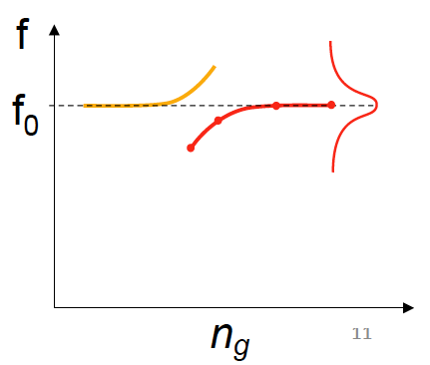
3
1
2
2
3
1

Slide 5
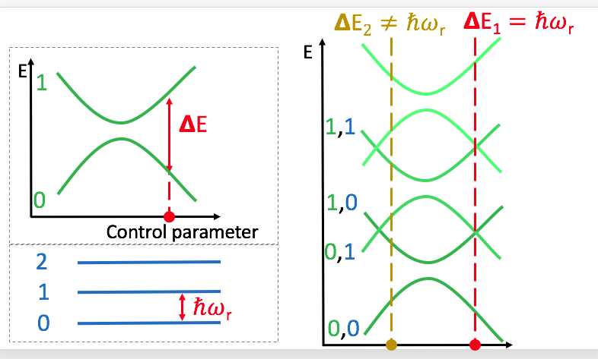
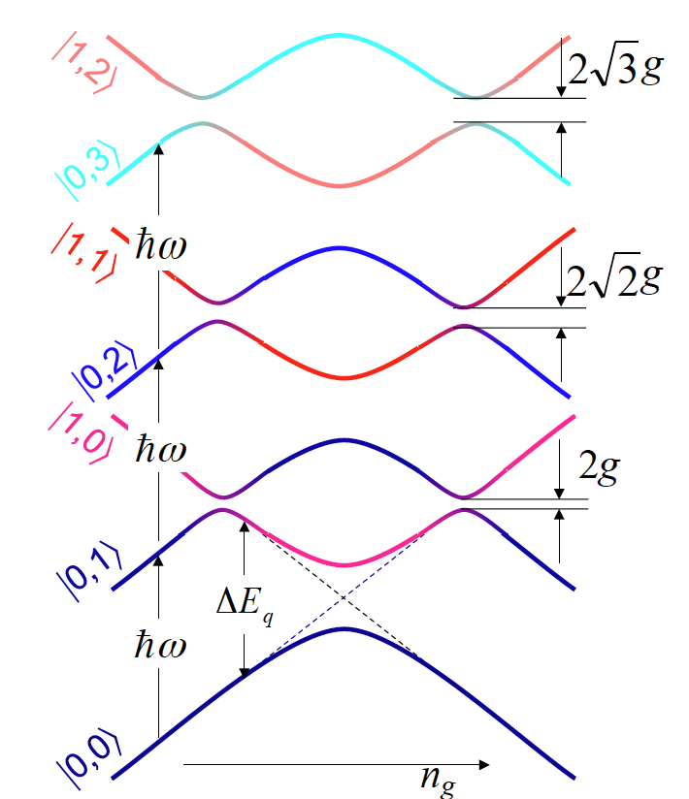

Slide 7
q3
q1
q2
Charge not defined, due
To connection with ground

Slide 8
\

Slide 9
IN

Slide 10
w₄
w₃
w₂
w₅
w₁
w₆
w₇

Slide 11
1/1000 divider
1MΩ
Filters
Qubit System

Slide 13
Emission strength

Slide 14
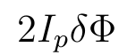
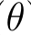
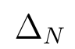
Emission strength
Z
2a
x

Slide 15
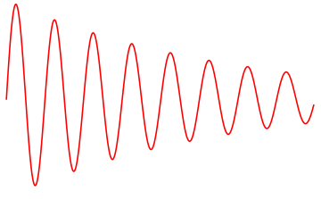

Slide 16
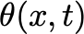
-L/2
x

Slide 17
g(t)
Area = g(0)t_c

Slide 19
in
readout
in
readout
Transmission line
Qubit
Qubit

Slide 20
in
Qubit
Qubit

Slide 21
f_{mod}
f_{mod}

Slide 22
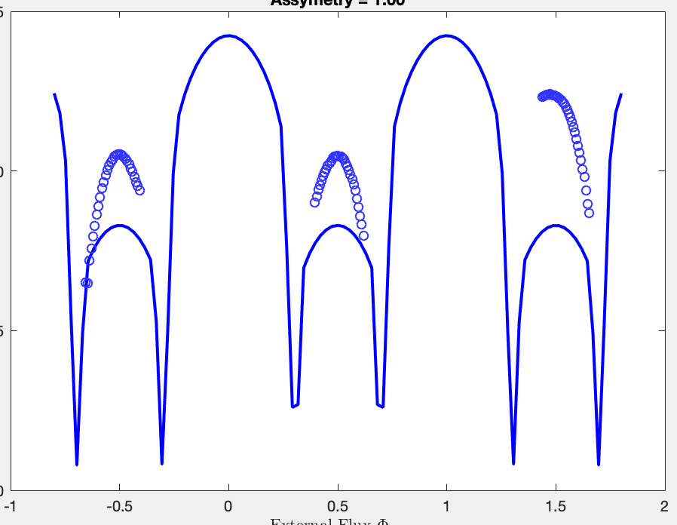
alpha

Slide 23
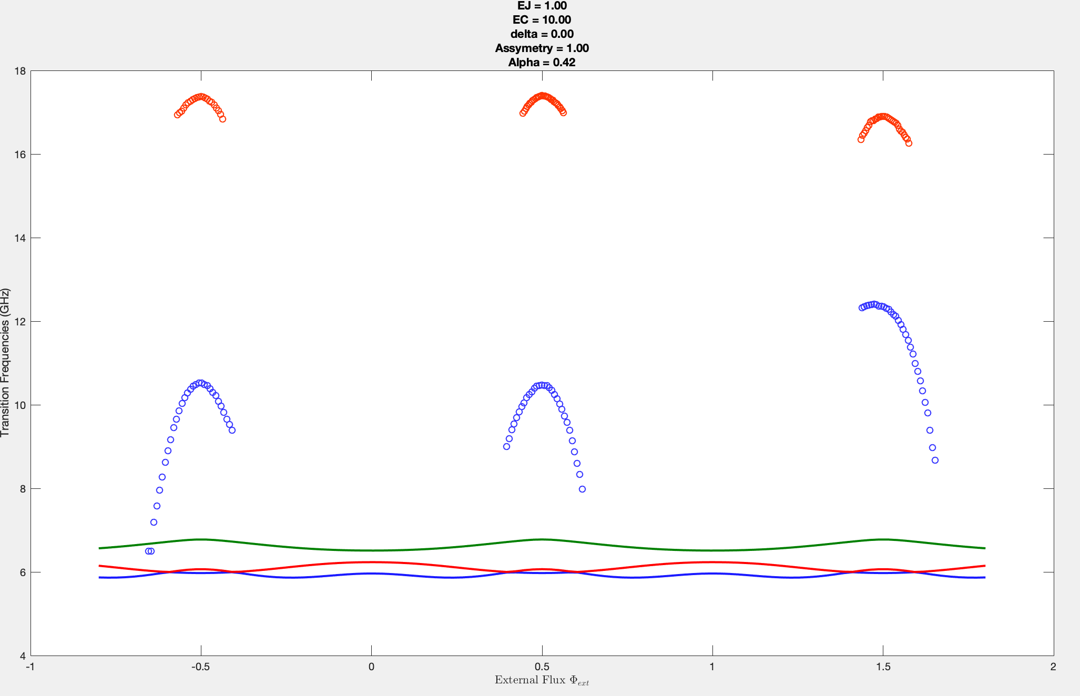
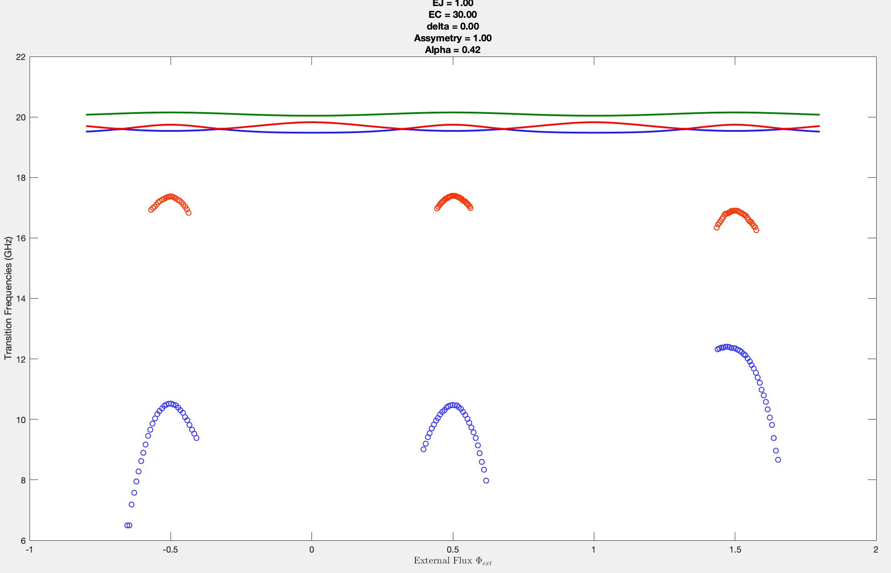
Increase
EC

Slide 24
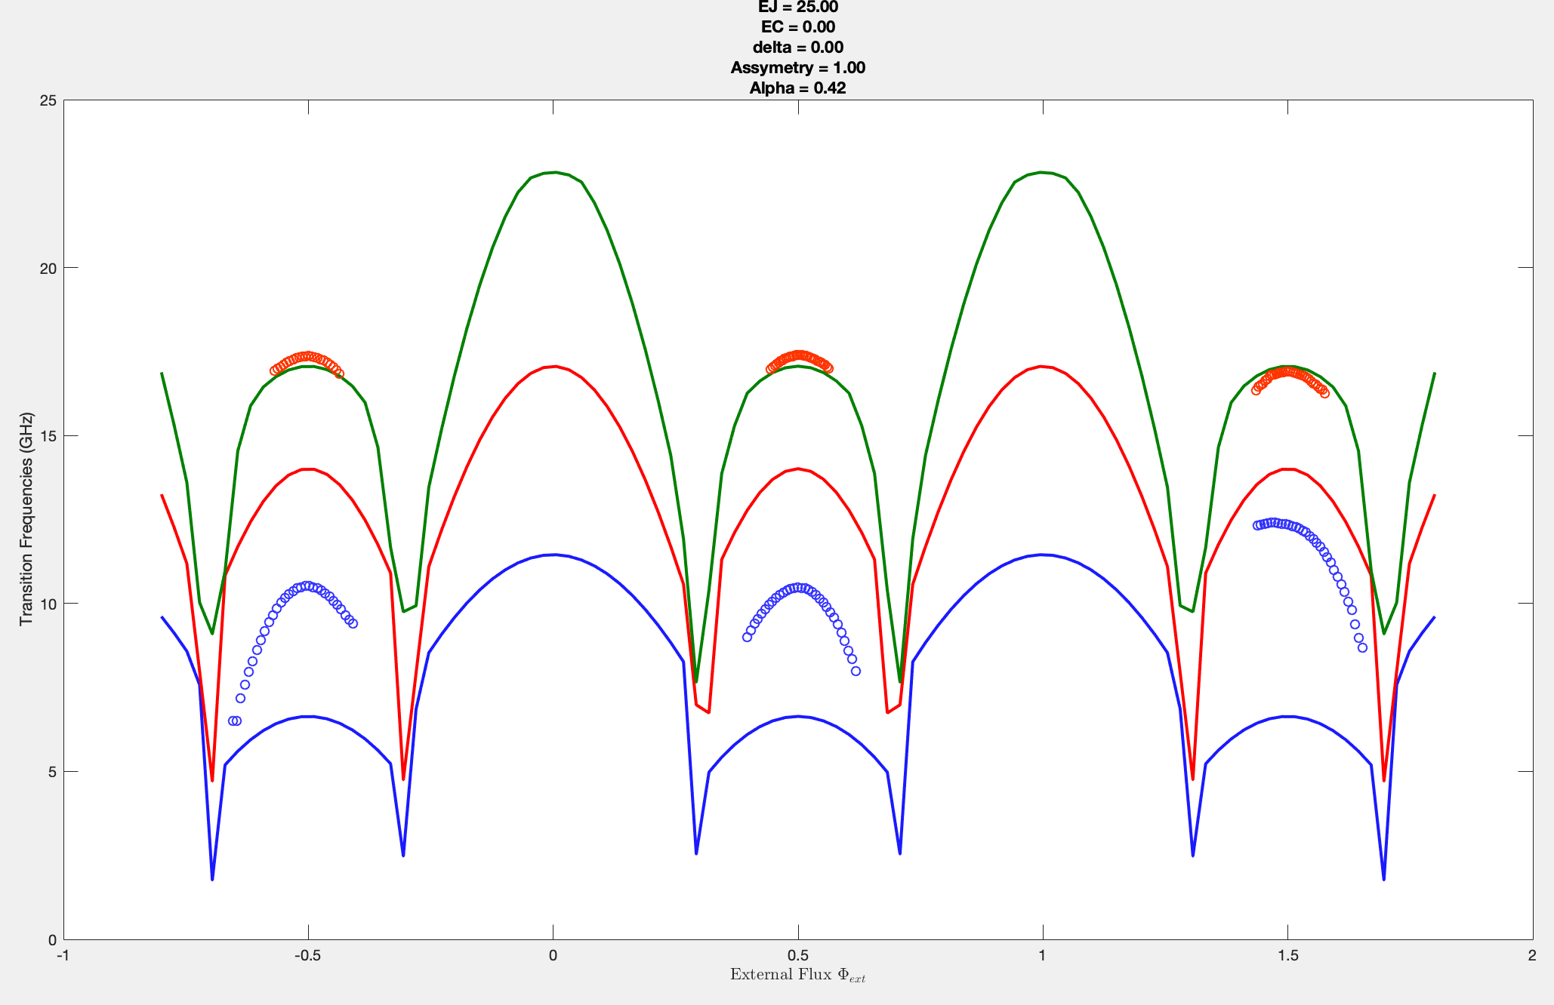
Increase
EJ

Slide 25
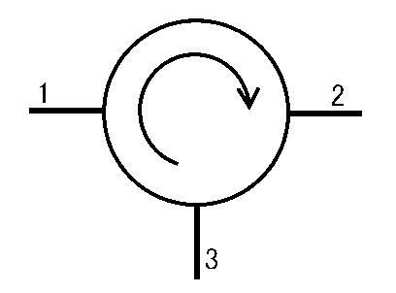
Photon signal
MIXER
MIXER
Circulator
Amp 1
Amp 2

Slide 26
Power spectral density
Power
f

Slide 27
0
0

Slide 28
?
?
?
?
?
?
?
?
?
Collective signal
?
?
?
Average signal every 2.5ns

Slide 29
MIXER
Gain
x40dB
?
MIXER
A1
Noise
-172 dBm/Hz
(45K)
-132 dBm/Hz

Slide 30
MIXER
Gain
x40dB
x28dB
?
MIXER
A1
A3
-115dBm/Hz
noise
Noise
-172 dBm/Hz
(45K)
-132 dBm/Hz
-111 to -104 dBm/Hz

Slide 31
In
Transmon
In
Out
-V_{sc}
V_{sc}

Slide 32
IN
OUT

Slide 33
OUT
A
B

Slide 34
MIXER
Gain
x40dB
x28dB
x28dB
?
MIXER
A1
A3
A3
-115dBm/Hz
noise
-115dBm/Hz
noise
Noise
(dBm/Hz)
-172 (45K)
-132
-111
-85

Slide 35
M(t)
B(0)
B(1)
B(2)
X(t-2)
X(t-1)
X(t-0)

Slide 36
System
Excitation pulses
Change delay
VNA readout
1Hz BW on VNA
VNA
e.g.
200ns

Slide 37
System
Excitation pulses
Change delay
VNA readout
1Hz BW on VNA
VNA
e.g.
200ns

Slide 38
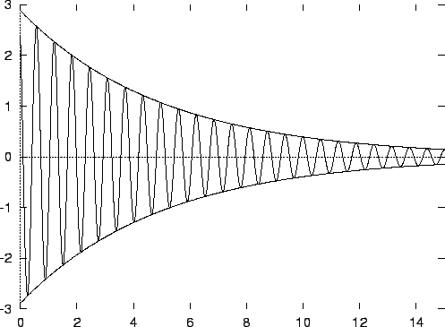
A(t)
10GHz field in
10GHz field out
Transmon
B(t)
t0
A(t)
t
B(t)

Slide 39
Driving field
Transmon
Cc
Ce
t0
A(t)
t
B(t)

Slide 40
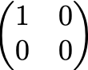
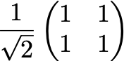
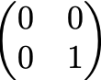
|1>
|1>
|1>
Incoherent relaxation takes
1/Gamma = 10ns
To produce single photon
|0>
|0>
|0>
Coherent emission
Would be maximised
Here if the pulse was stoped
Coherent Rabi oscillation if pulse
was stopped at different points

Slide 41
|1>
|1>
|1>
Incoherent relaxation takes
1/Gamma = 10ns
To produce single photon
|0>
|0>
|0>
as1m0v5_l4ws
Coherent emission
Would be maximised
Here if the pulse was stoped
Coherent Rabi oscillation if pulse
was stopped at different points

Slide 42
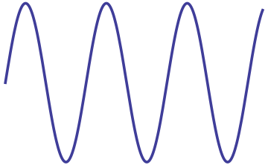
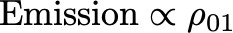
Pulses
Mixer
Mixer
VNA
Mixer
Chopper
Excited state

Slide 43
Pulses
VNA
To
VNA
From
system
Mixer
Mixer
Mixer
Mixer
Mixer
Mixer
Chopper1
Chopper2

Slide 44



A
B
C
Pulse In
Pulse Out
Average
on VNA
Pulse In
B
A
40ns
40ns
Pulse Out
C
100ns
100ns
Average for 0.2s

Slide 45
100ns
100ns
100ns
Pulse In
Emission
from atom
Readout
40ns
40ns
40ns
Average
Emission
Strength
Average for 0.2s

Slide 46
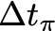
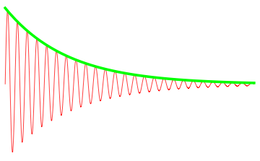
100ns
100ns
100ns
Pi Pulse
Emission
from atom
Readout
t
t
t
Average @
t (ns) after
excitation
Average for 0.2s

Slide 47
100ns
100ns
100ns
Pulse In
Emission
from atom
Readout
Average
Out
Average for 0.2s

Slide 48
A
B
C
Pulse In
Pulse Out
Average
on VNA
Pulse In
100ns
100ns
Average for 0.2s

Slide 49
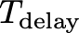
Internal offset
100ns
100ns
100ns
100ns

Slide 50
T
Trigger
Digitiser samples every 2.5ns
Digitiser samples every 2.5ns

Slide 51


Slide 52
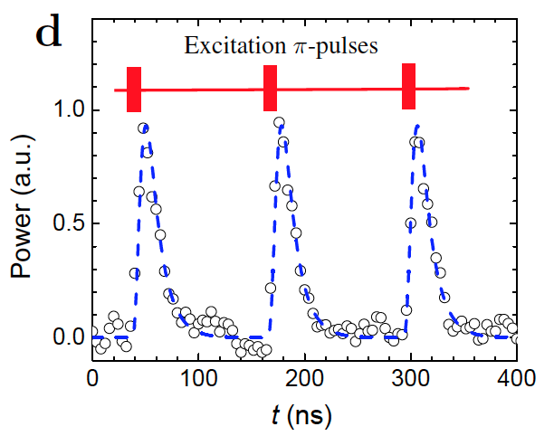
|1>
|1>
Single photon emission
|0>
|0>

Slide 53
Emission strength

Slide 54
Read
Process
Accumulate
X
Accumulate
Read
Process
Y
Process
Accumulate
Read
Z
One program cycle

Slide 55
250ns
250ns
250ns
Pulse In
Emission
from atom
A^2+B^2
Average over many repetitions
250ns

Slide 56
N = 64M samples
T
Pulse In
Emission
from atom
g1 evaluated over full set
T
g1

Slide 57
f_{e}± f_{mod}

Slide 58
f_{p}+ f_{mod}± f_{mod} = f_{p} + 2f_{mod} or f_{p}

Slide 59
f_{mod}
f_{e}± f_{mod}
N=99
hf_{e}
N=100
N=99

Slide 60
f_{mod}
f_{mod}
f_{p}-f_{mod}
f_{p}
f_{p}+ f_{mod}

Slide 61
P_{e}
Amplitude
f_{mod}

Slide 62
V
Time

Slide 63
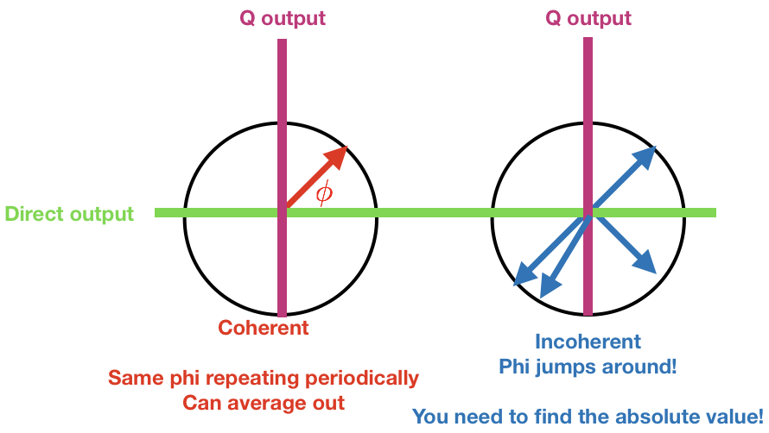
Real part
\
t

Slide 64
Real
f_{p}-f_{mod}
f_{p}+f_{mod}
Marki Mixer
f_{p}-f_{mod}
f_{p}+f_{mod}
f_{p}-f_{mod}
f_{p}+f_{mod}
Im

Slide 65
Q output
Q output
Direct output
Coherent
Same phi repeating periodically
Can average out
Incoherent
Phi jumps around!
You need to find the absolute value!

Slide 66





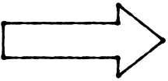

B output
SP digitiser
A output
Filter
FROM SYSTEM
Filter

Slide 67

B output
SP digitiser
A output
FROM SYSTEM
Filter

Slide 68
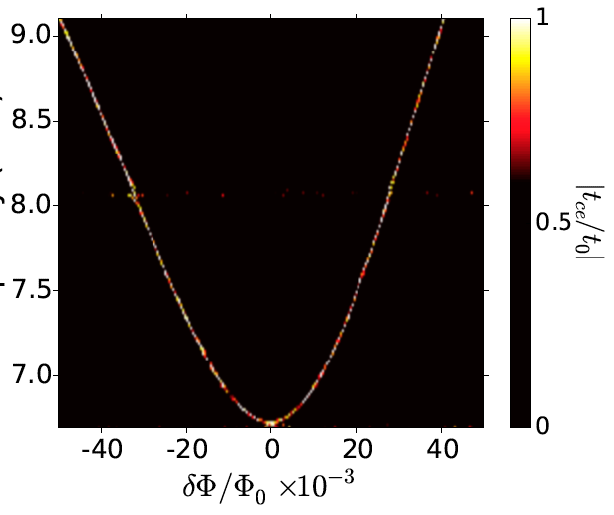
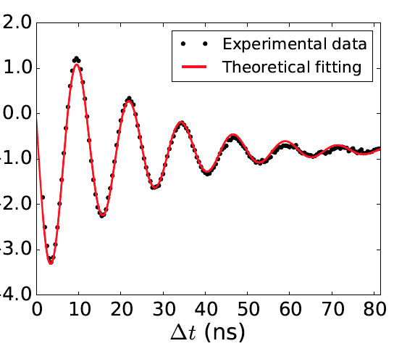
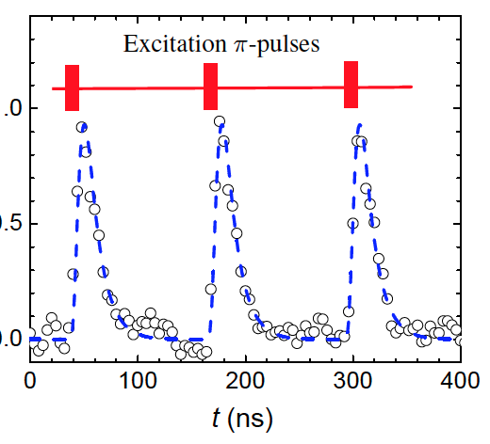
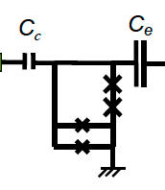
Pulse generator
SP Digitiser
Trigger
-10dBm
Transmission
Rabi Oscillations
-30dBm
Detect photons
I

Slide 69
Pulse generator
SP Digitiser
Trigger
-10dBm
Transmission
Rabi Oscillations
-30dBm
Detect photons
I

Slide 70
6
11
4
1 or 2
-10dBm
-10dBm
-30dBm
-30dBm
Short circuit using cell Ty wires
Short circuit

Slide 71
INPUT
OUTPUT
1
2
3
4
5
6
1
2
7
8
9
10
3
4
11
12
6
10
12
Cell Ty (back wall)
Cell Ay (computer)
RF for DC

Slide 72
Marki
DC to 1000MHz
Pulse
8.2ns
10MHz
3dBm
3dBm
Anritsu power divider
VNA
2dBm
13dBm
Marki
Marki
3dBm
10dBm
3dBm
3dBm
3dBm
3dBm
Trigger
Compensation
14dBm
Mini circuit power splitter
SP Digitiser
I

Slide 73
Marki
DC to 1000MHz
Pulse
8.2ns
10MHz
3dBm
3dBm
Anritsu power divider
VNA
Marki
Marki
3dBm
10dBm
3dBm
3dBm
3dBm
3dBm
Compensation
Trigger
14dBm
Marki mixer
MATCH
SP Digitiser

Slide 74
Marki
DC to 1000MHz
Pulse
8.2ns
10MHz
3dBm
3dBm
Anritsu power divider
Marki
Marki
VNA
3dBm
3dBm
3dBm
3dBm
10dBm
3dBm
Compensation
Trigger
9dBm
Marki mixer
SP Digitiser

Slide 75
Marki
DC to 1000MHz
Pulse
8.2ns
10MHz
3dBm
3dBm
VNA
0dBm
Marki
Marki
3dBm
3dBm
3dBm
Generator
0dBm
Compensation
Trigger
9dBm
Marki mixer
SP Digitiser

Slide 76
Marki
DC to 1000MHz
Pulse
70ns
2.5MHz
3dBm
3dBm
VNA
10dBm
Marki
Marki
3dBm
3dBm
3dBm
Generator
-17dBm
Trigger
Marki mixer
SP Digitiser

Slide 77
VNA
0dBm
Generator
0dBm
Marki mixer
SP Digitiser

Slide 78
Anritsu power divider
VNA
2dBm
3dBm
10dBm
3dBm
14dBm
14dBm
Marki mixer
SP Digitiser

Slide 79
System
VNA
Chopper
Pulse
generator
T
Trigger
?
?
?
SP Digitiser
T

Slide 80
System
VNA
Chopper
Pulse
generator
T
Trigger
Mixer
?
?
?
Low Pass Filter
SP Digitiser
T

Slide 81
Rabi
Marki
DC to 1000MHz
Pulse
10MHz
3dBm
3dBm
VNA
5dBm
-20dB
Marki
Marki
3dBm
3dBm
3dBm
+12dB
-10dB
+35dB
-30dB
I

Slide 82
Direct spectroscopy
VNA, f
-15dBm
-30dB
+28dB
-20dB
+12dB
-10dB
+35dB
Vary
I – current in the coil
F – frequency on VNA
-30dB
I

Slide 83
Smith
VNA, f
-15dBm
-30dB
+28dB
-20dB
+12dB
-10dB
+35dB
Vary
f – frequency on VNA
P – power of VNA
-30dB
I

Slide 84
3rd Feb 2018 Rabi with Power splitter
Marki
DC to 1000MHz
Pulse
T
10MHz
3dBm
3dBm
Anritsu power divider
VNA
P
-20dB
Marki
Marki
3dBm
10dBm
13dBm
3dBm
3dBm
3dBm
+12dB
+28dB
-10dB
+35dB
Vary
t – pulse length
P – power of pulse
-30dB
I

Slide 85
3rd Feb 2018 Incoherent
Marki
DC to 1000MHz
Pulse
T
3dBm
3dBm
Anritsu power divider
VNA
-20dB
Marki
Marki
3dBm
10dBm
13dBm
3dBm
3dBm
3dBm
+12dB
+28dB
Trigger
Vary
T – pulse length
F – frequency on SPA
-10dB
+35dB
SPA
f
-30dB
I

Slide 86
3rd Feb 2018 T1
Marki
DC to 1000MHz
Pulse
Pi-pulse fixed
Repetition fixed
Move bucket
3dBm
3dBm
Bucket
Anritsu power divider
VNA
Power fixed
Frequency fixed
-20dB
Marki
Marki
3dBm
10dBm
13dBm
3dBm
3dBm
3dBm
+12dB
+25dB
Marki
DC to 1000MHz
3dBm
3dBm
3dBm
Marki
3dBm
Marki
3dBm
-10dB
+35dB
-30dB
I

Slide 87
3rd Feb 2018 Photon counting
Marki
DC to 1000MHz
Pulse
Pi-pulse fixed
Repetition fixed
3dBm
3dBm
Anritsu power divider
VNA
Power fixed
F fixed
-20dB
Marki
Marki
3dBm
10dBm
13dBm
3dBm
3dBm
3dBm
+12dB
+25dB
3dBm
Trigger
-10dB
+35dB
Marki Mixer
SP Digitiser
-30dB
I

Slide 88
19th Feb Testing digitiser
Marki
DC to 1000MHz
Pulse
100ns
1MHz
3dBm
3dBm
Anritsu power divider
VNA
20ns delay
7GHz
-15dBm
Marki
Marki
3dBm
10dBm
3dBm
3dBm
3dBm
3dBm
Trigger
10MHz Sync
Marki Mixer
SP Digitiser

Slide 89
4th Mar Testing Noise
Marki
DC to 1000MHz
Pulse
20ns
0.1MHz
3dBm
3dBm
Anritsu power divider
VNA
delay
7GHz
5dBm
Marki
Marki
3dBm
10dBm
3dBm
3dBm
3dBm
3dBm
Trigger
10MHz Sync
Marki Mixer
SP Digitiser

Slide 90
Marh 2018 Photon counting
Marki
DC to 1000MHz
Pi-pulse (12.2)
Repetition fixed (5MHz)
3dBm
3dBm
VNA
Power fixed –10dBm)
F fixed (7GHz)
-20dB
Marki
Marki
13dBm
3dBm
3dBm
3dBm
+40dB
Trigger
+
Clock refference
-10dB
+35dB
Marki Mixer
SP Digitiser
Filter
-30dB
Generator
Power 10dBm
Freq 7Ghz
I

Slide 91
Marh 2018 Photon counting
Marki
DC to 1000MHz
Keysight
Pulse Gen
3dBm
3dBm
VNA
-20dB
Marki
Marki
13dBm
3dBm
3dBm
3dBm
Trigger
+
Clock refference
+50dB
-10dB
+35dB
Marki Mixer
1
2
3
4
SP Digitiser
Filter
-30dB
+20dB
Generator
I

Slide 92
Signal from system
Marki Mixer
Signal from system
Trigger
+
Clock refference
2
3
4
SP Digitiser
Filter
+20dB
Generator

Slide 93
Marki Mixer
Approx. DC signal
Trigger
+
Clock refference
2
3
4
SP Digitiser
Filter
+20dB
Generator

Slide 94

3rd Feb 2018 Incoherent
VNA
f_{probe}
Anritsu power divider
Generator
f_{e}
-20dB
3dBm
-3dB
13dBm
+12dB
+28dB
3dBm
Trigger
Vary
T – pulse length
F – frequency on SPA
-10dB
+35dB
Marki Mixer
SPA
f
-30dB
f_{probe}±f_{mod}
Coupler
f_{probe,}f_{e}±f_{mod}

Slide 95
3rd Feb 2018 Incoherent
VNA
f_{probe}
3dBm
2
3
Anritsu power divider
Generator
f_{e}± f_{mod}
-20dB
3dBm
3dBm
-3dB
13dBm
+12dB
1
+28dB
-10dB
5
+35dB
SPA
f_{probe}
4
-30dB
f_{probe}±f_{mod}
Coupler
f_{probe,}f_{e}±f_{mod}

Slide 96
3rd Feb 2018 Incoherent
VNA
f_{probe}+ f_{mod}
3dBm
Anritsu power divider
Generator
f_{e}± f_{mod}
-20dB
3dBm
3dBm
-3dB
13dBm
+12dB
+28dB
f_{mod}
Keysight
Pulse Gen
f_{mod}
-10dB
+35dB
Marki Mixer
SPA
f_{probe}
-30dB
f_{probe}±f_{mod}
Coupler
f_{probe,}f_{e}±f_{mod}

Slide 97
Generator
f_{e} (0-15GHz)
P_{e} (-50-0dBm)
3dBm
Marki Mixer
-30dB
3dBm
3dBm
VNA
f_{probe} = 2GHz
P_{probe} 10dBm
13dBm
+12dB
+28dB
-10dB
+35dB
-30dB
f_{probe}
Coupler
f_{probe,}f_{e}

Slide 98
12th October Bucket TiBridge
Marki
DC to 1000MHz
3dBm
3dBm
Gen
15GHz, 3dBm
3dBm
Marki
3dBm
Marki
3dBm
3dm
Divider
Marki
DC to 1000MHz
3dBm
3dBm
10dBm
3dBm
3dBm
3dBm
Marki
3dBm
Marki
3dBm
VNA
-20dBm, 3GHz, 2Hz
Keysight Pulse
Excitation 5µs
Keysight Pulse
Readout 100ns
Delay from 0 to 50µs
I

Slide 99
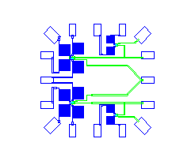
29/04/2018 – Hyb
Fabricated
28/04/2018
17
18
19
20
21
22
23
24
Ti Bridge samples (Gurtovoy)
Qubit bottom
Qubit top
G
16
2
1
G
15
2
14?
3
G
13?
4
1
G
G
12
11
10
9
8
7
6
5

Slide 100
05/12/2017 – Hyb
Fabricated
/ /2017
17
18
19
20
21
22
23
24
NbN_Hyb_Dec_05’17
Qubit bottom
Qubit top
G
16
2
1
G
15
2
14
3
G
13
4
1
G
G
12
11
10
9
8
7
6
5

Slide 101
24/05/2018 DC Samples
1 - TiN-2015-d-t-single
2 - TiN-2015-d-t
Fabricated
28/04/2018
17
18
19
20
21
22
23
24
Qubit bottom
Qubit top
G
16
2
1
G
15
2
14?
3
G
13?
4
1
G
G
12
11
10
9
8
7
6
5

Slide 108
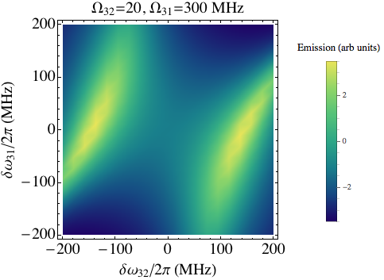
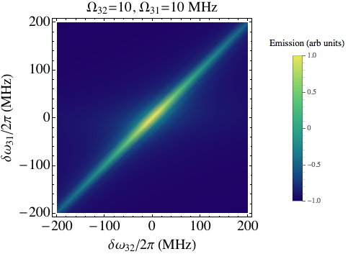
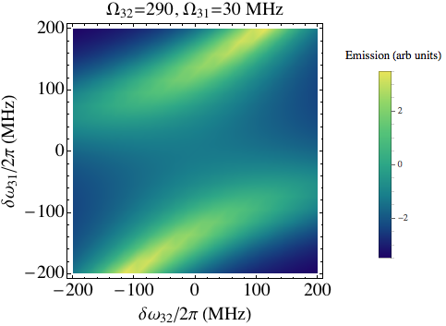
Large
Large

Slide 111
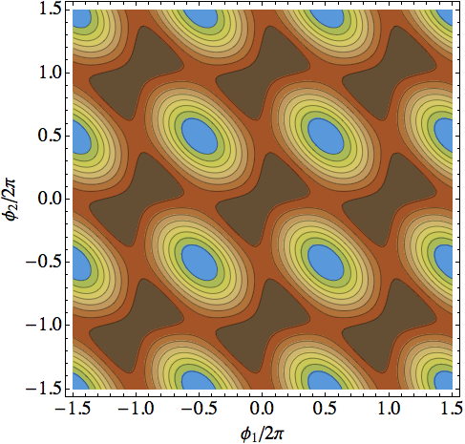
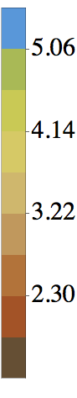
2.0
1.7
1.4
0.48
0.50
0.52

Slide 112
2.0
1.7
1.4
0.48
0.50
0.52

Slide 116
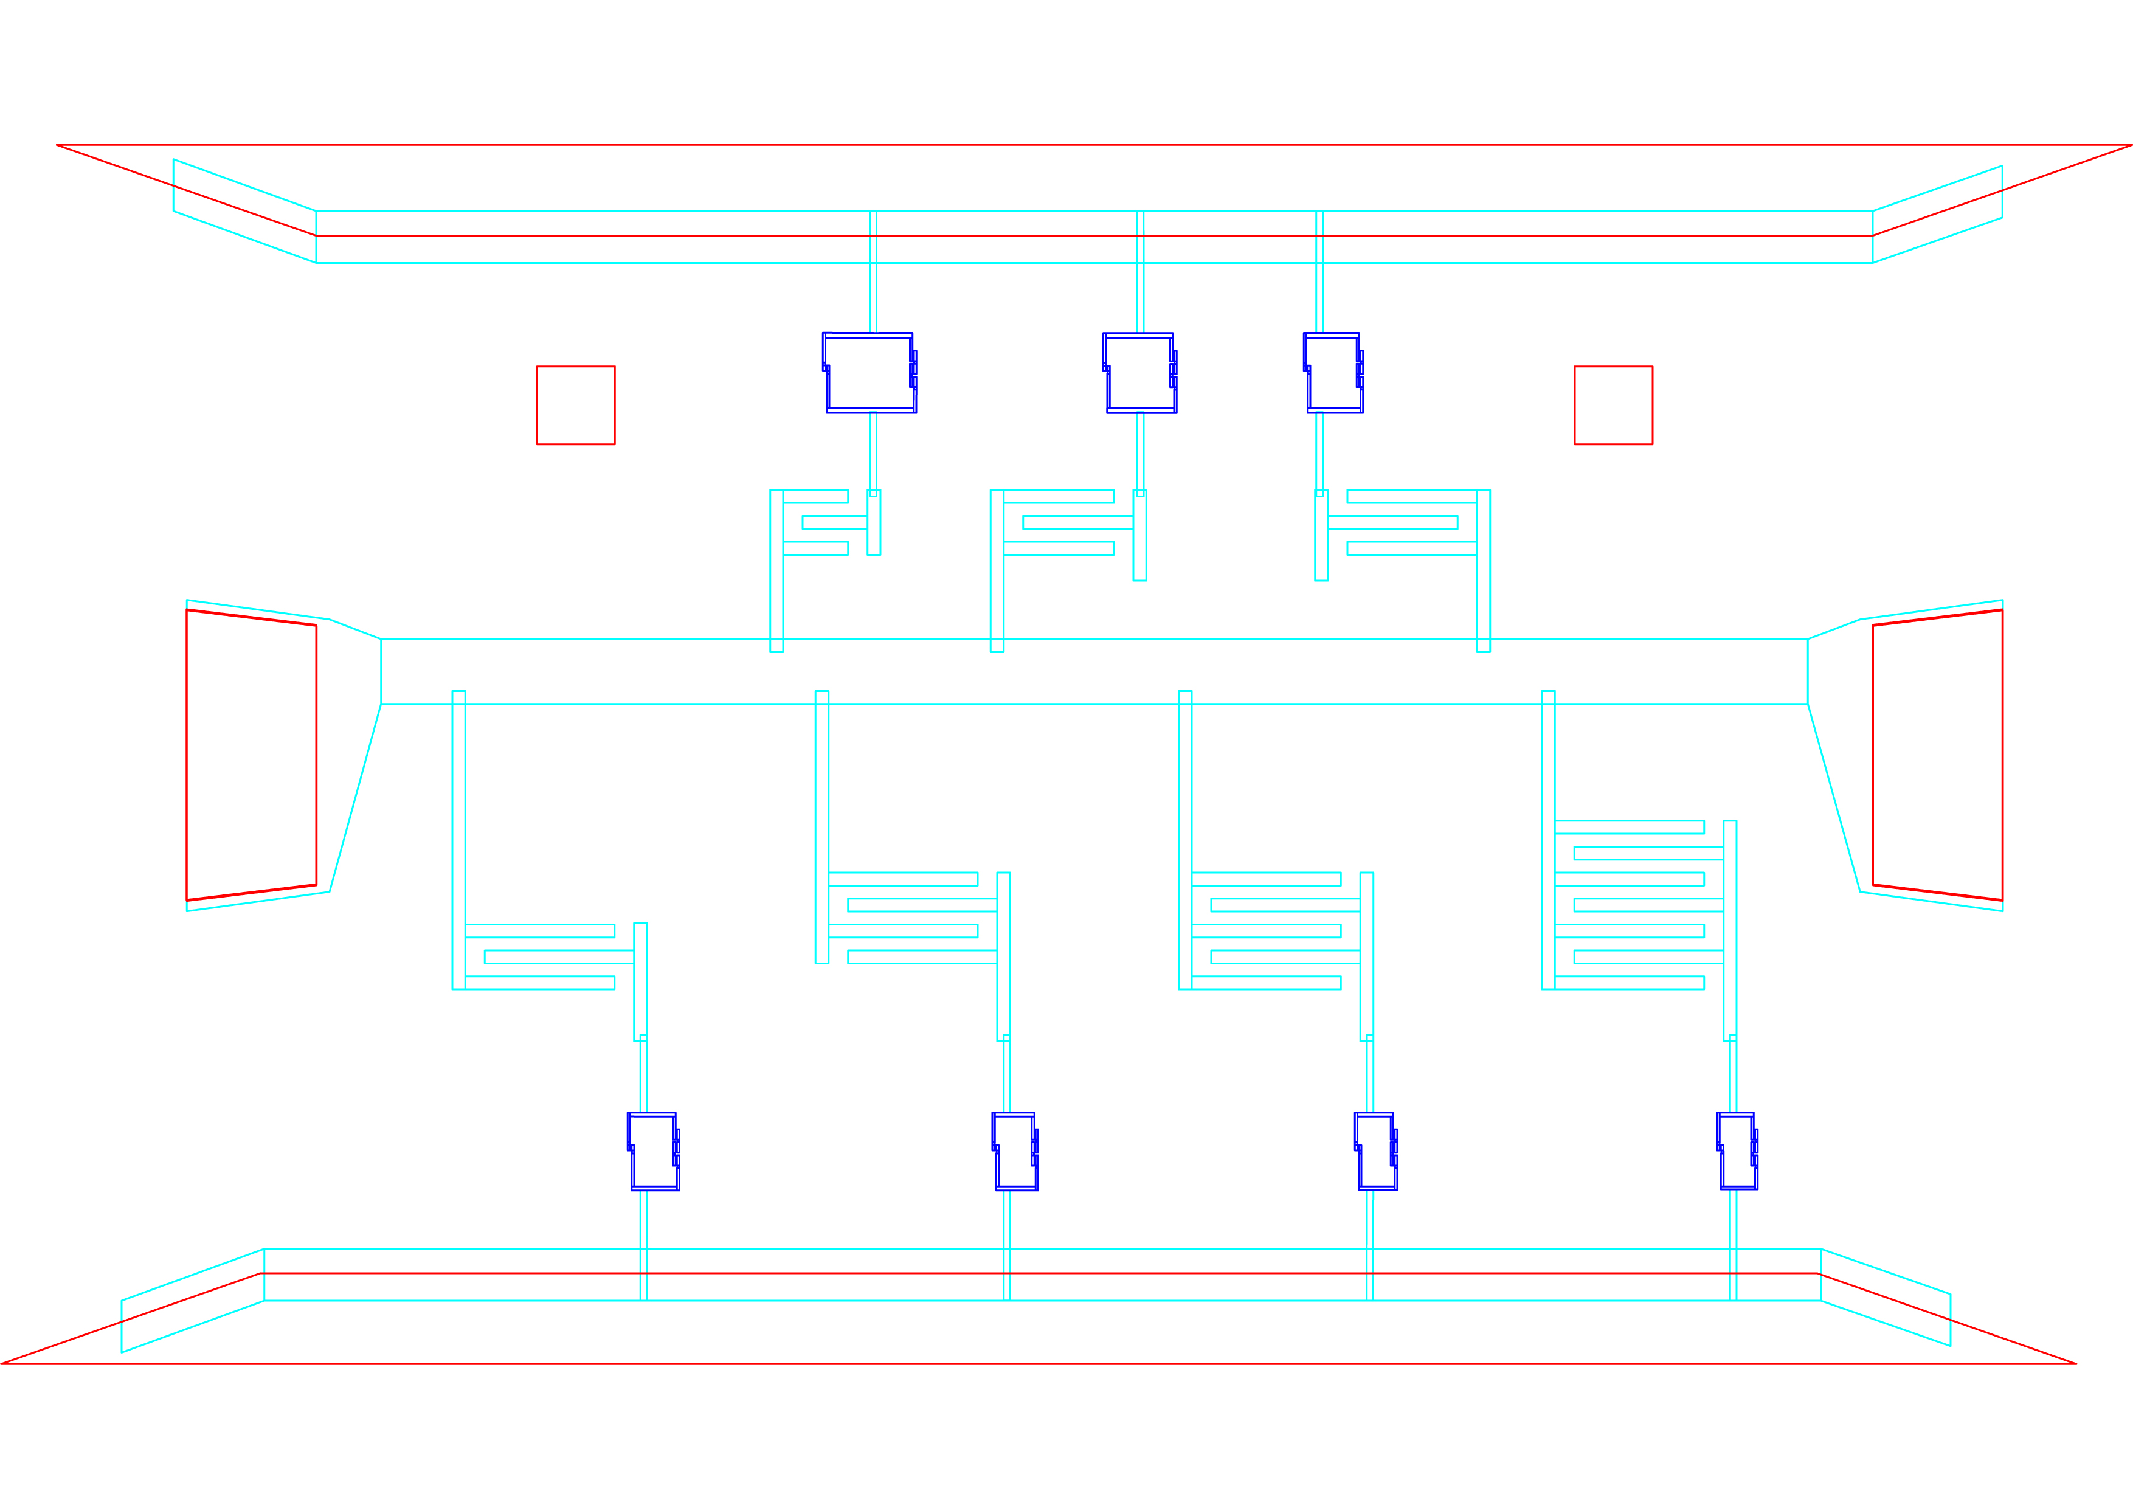

Slide 117
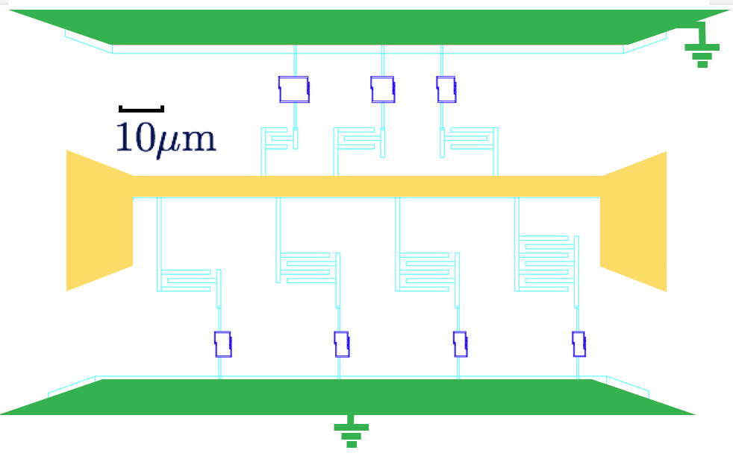
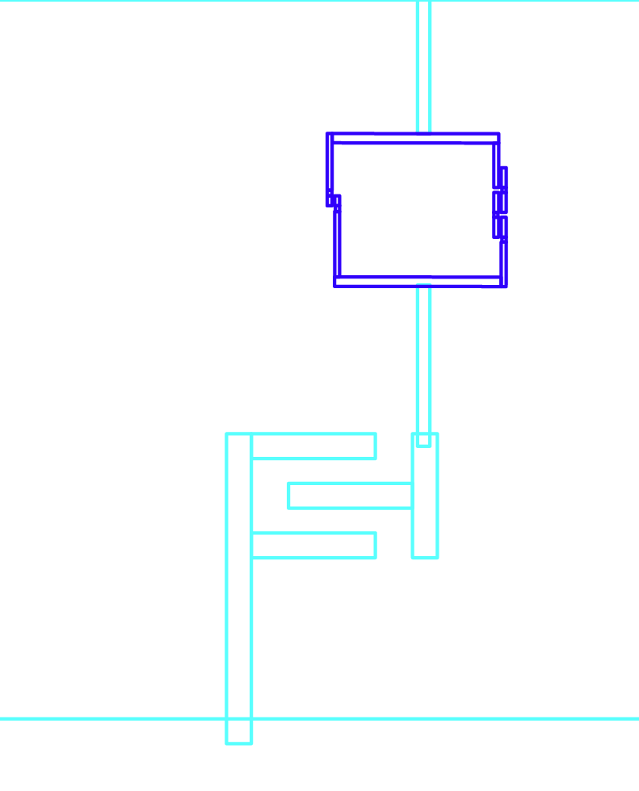
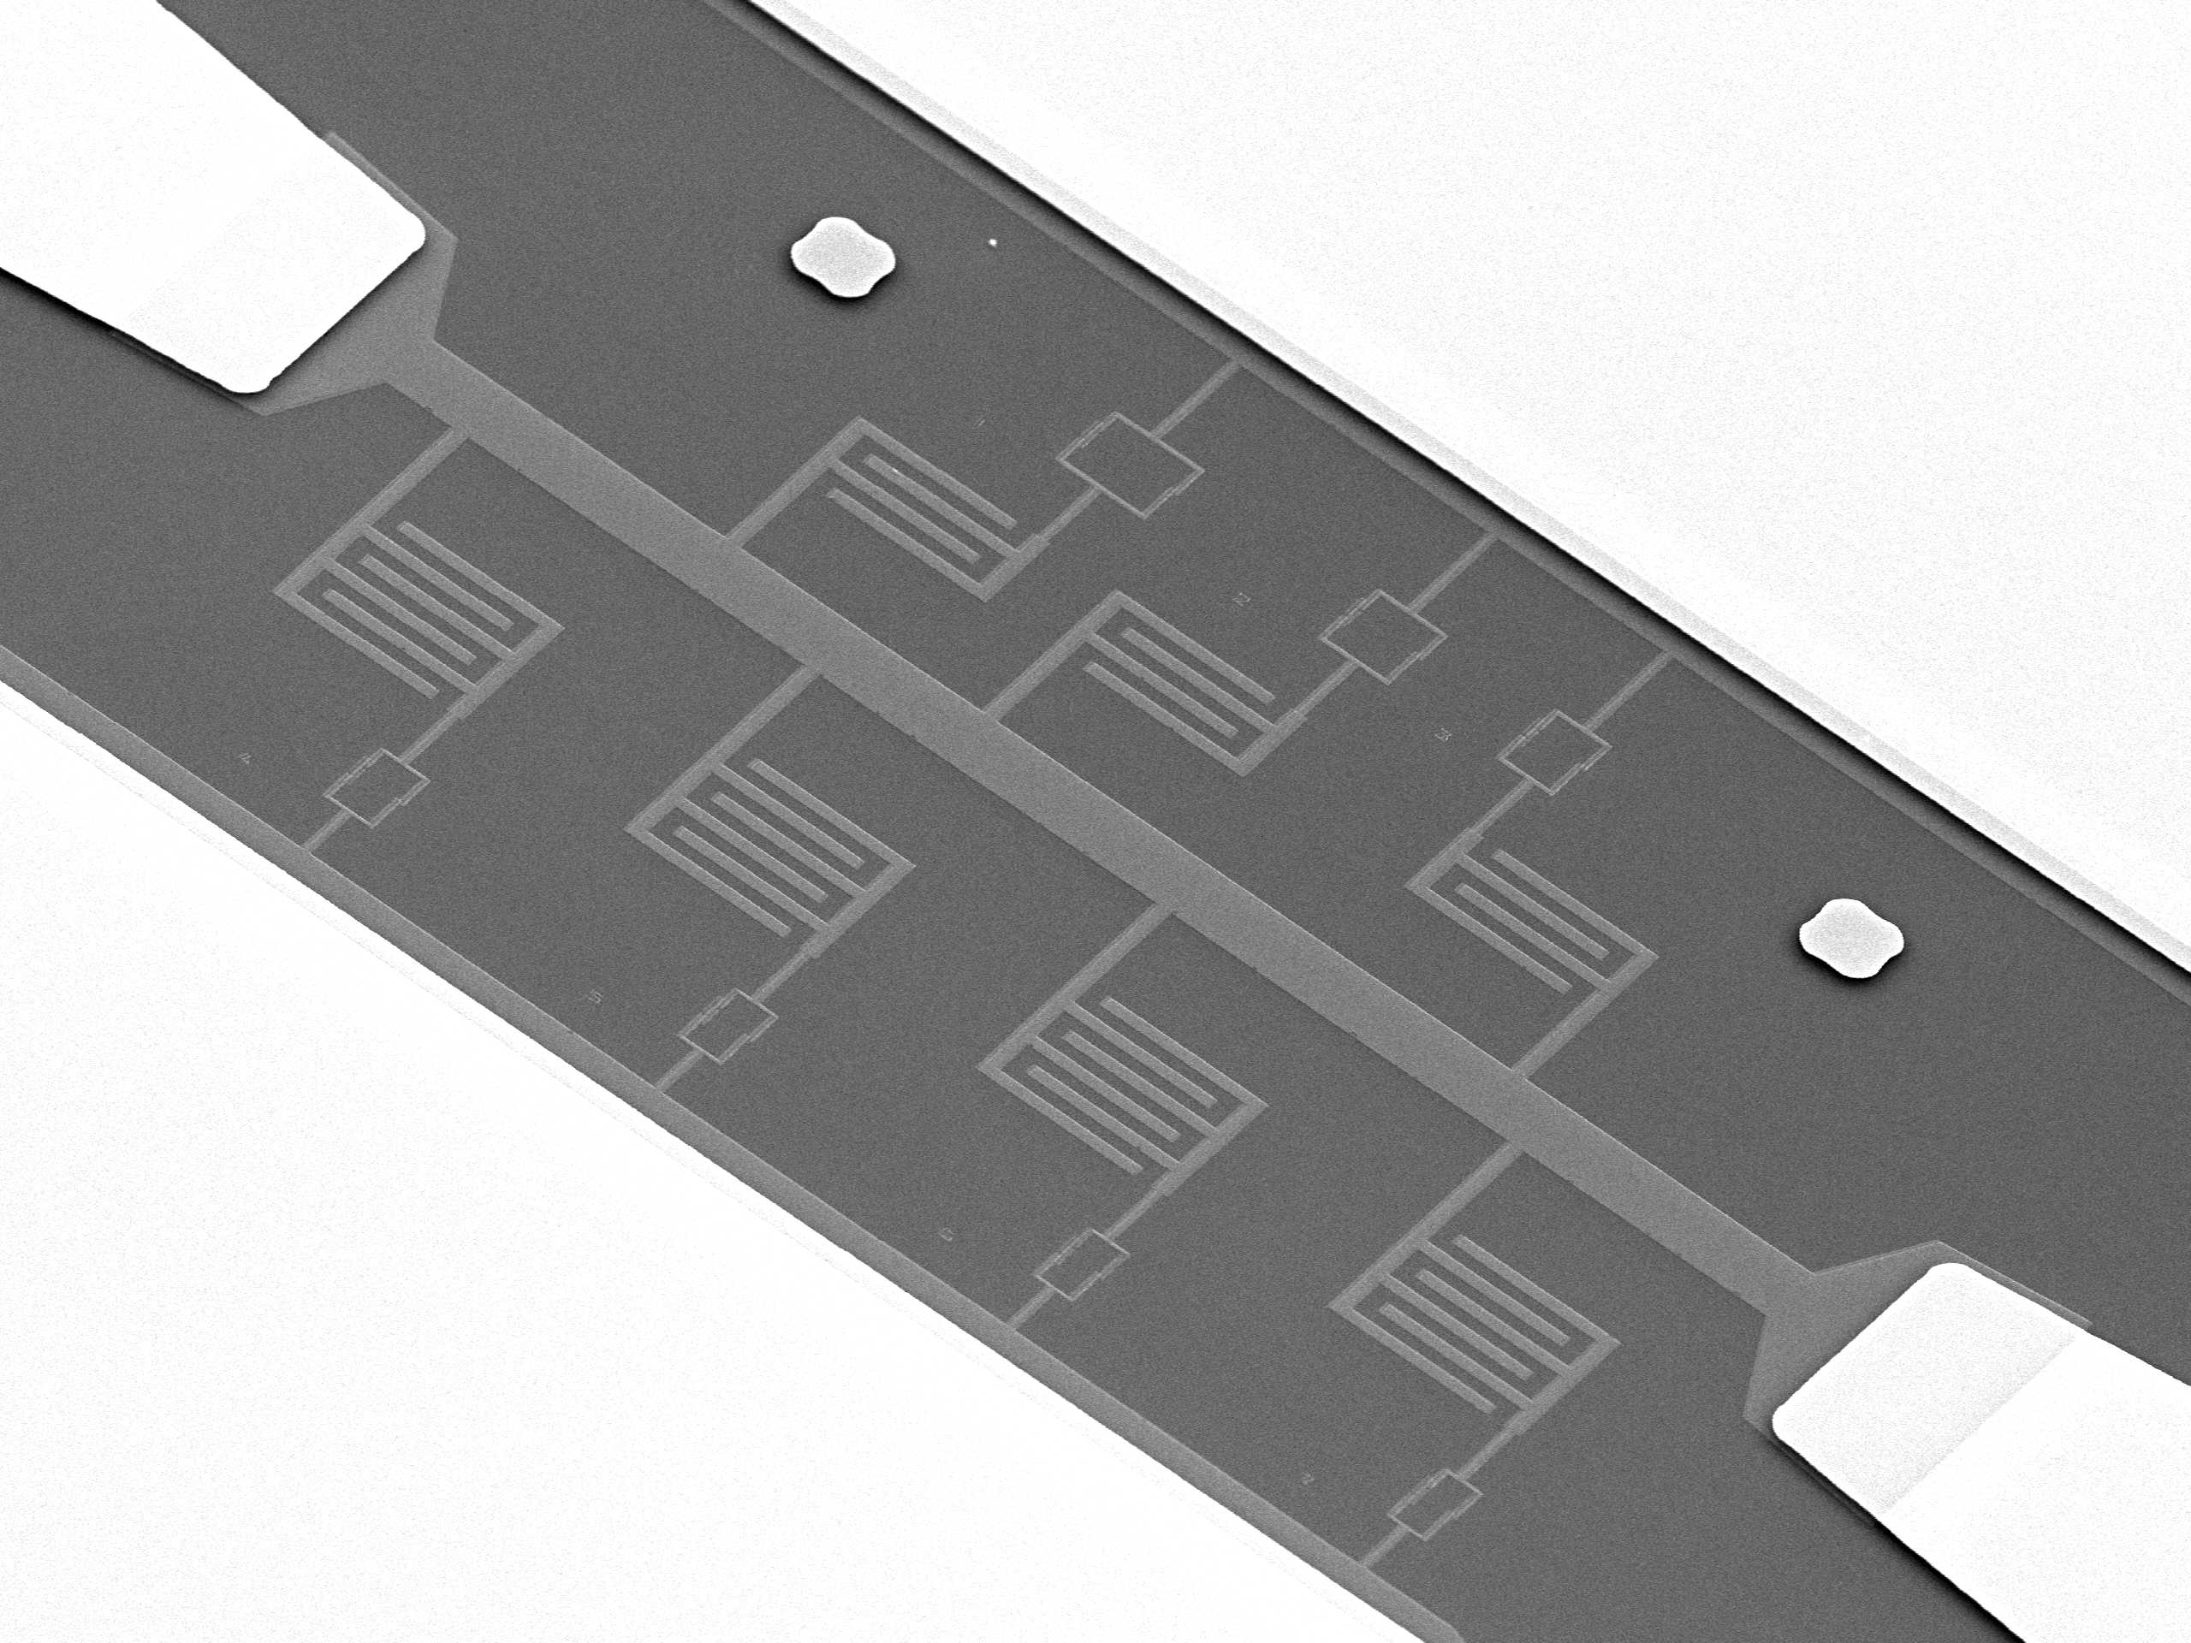
2
1
3
4

Slide 118
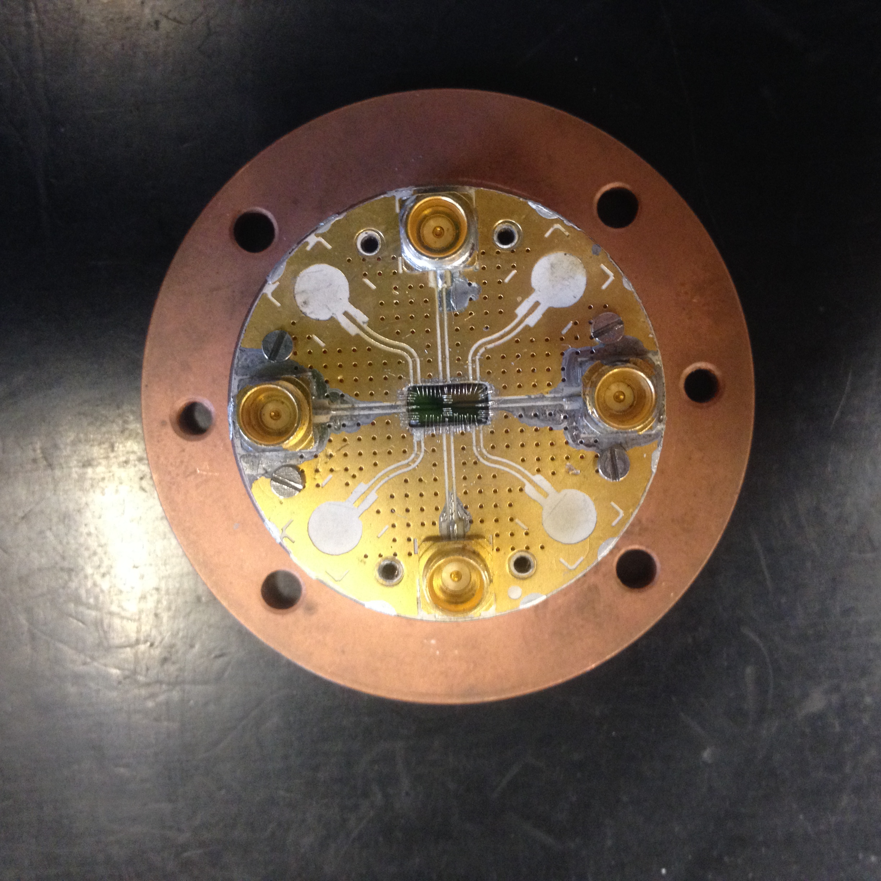
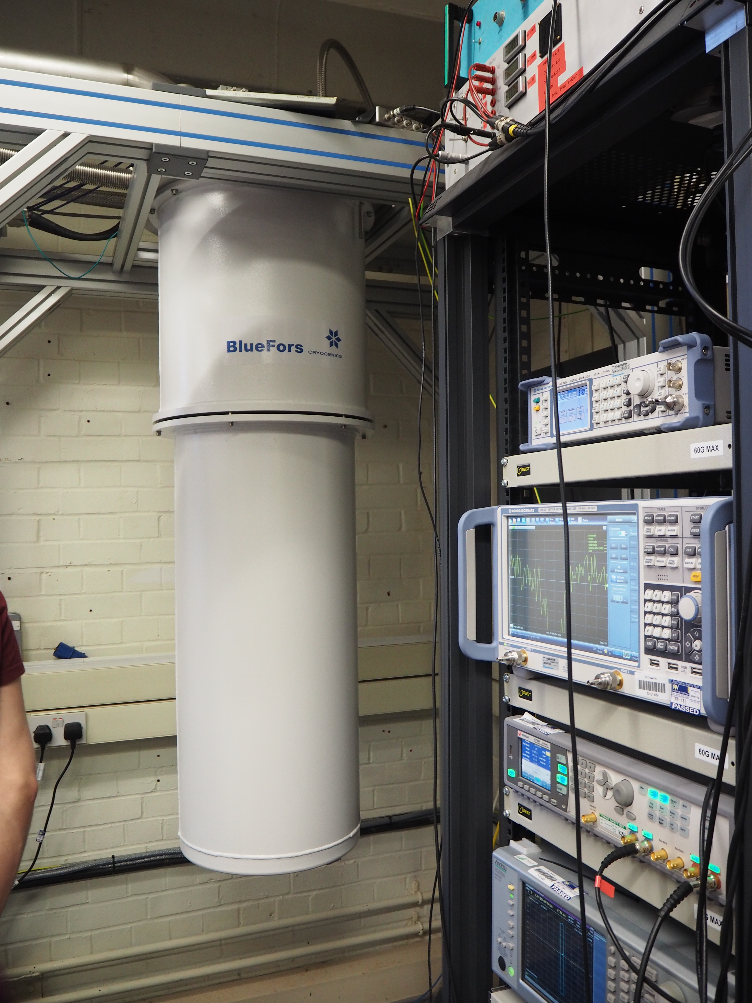
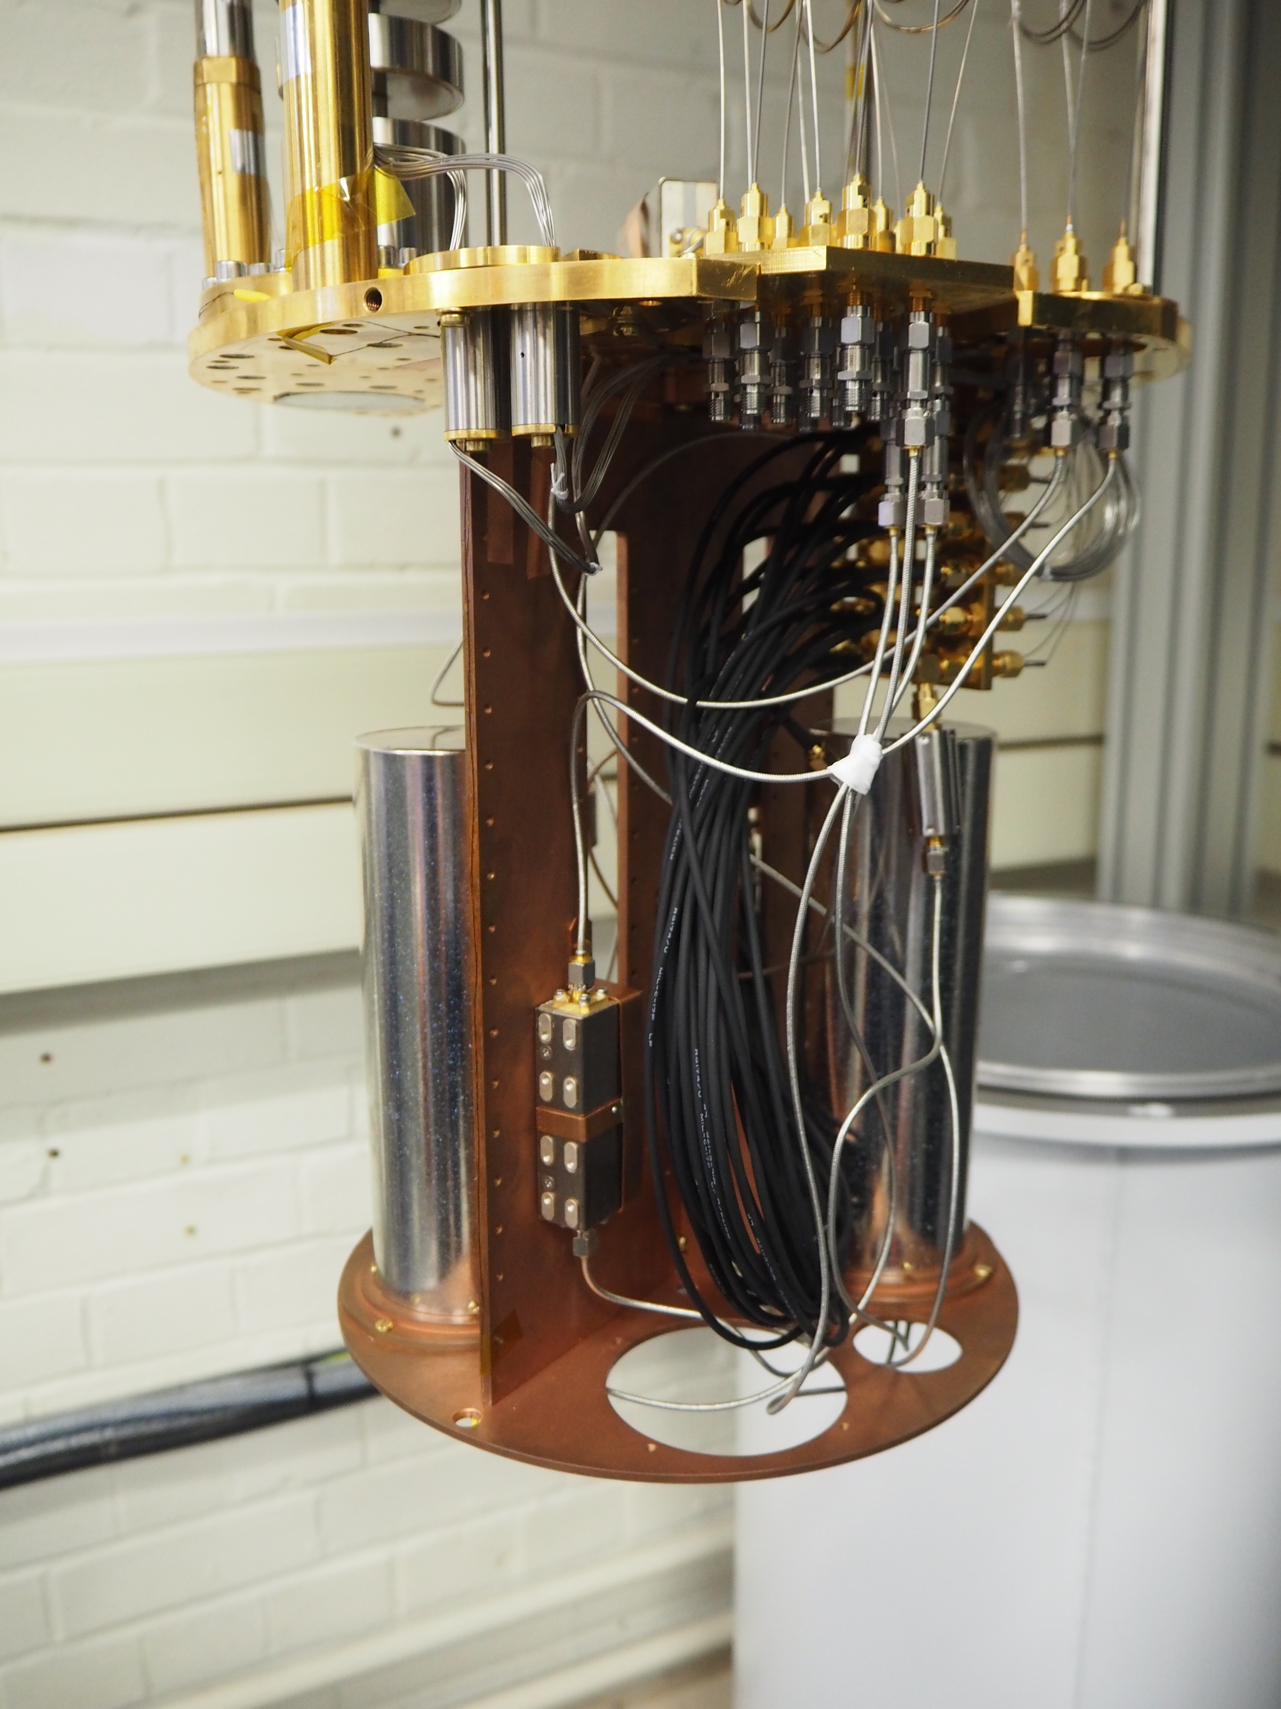
RF lines
Magnetic coil

Slide 119
Shot pitch
Shot size

Slide 120
To the left
To the right
Before
With overlap, you can sort the elements across the boundary
-100nm Bias

Slide 121
-100nm Bias
+50nm Bias
MINUS
MINUS

Slide 122
58970,118000
Corner
D
64000,124000
2823,703
C
D
-3500, 2500
400
2900
490
-2550,600
-4450,600
66787,123341
Q 2787,659
59787,123341
P -4213,659
1900
B
A
7000

Slide 123
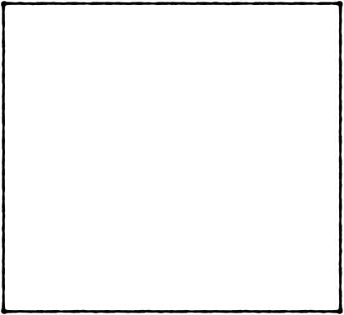
Full pattern
Full pattern
Individual fields at 100%
Individual fields at 25%
Stitches here will be very strong
Here each stitch is at 25%, so it will not be as prominent

Slide 124
330V
Ty
6
4
3
Ay
10
337V

Slide 125
Scratch the sample

Slide 126
Direct spectroscopy
VNA, f
-15dBm
-30dB
+50dB
-30dB
-10dB
+35dB
Vary
I – current in the coil
F – frequency on VNA
-30dB
System
I

Slide 127
Two tone
3dBm
Generator
Anritsu power divider
10dBm
VNA
P
-10dB
13dBm
3dBm
10dBm
+50dB
-10dB
+35dB
-30dB
System
I

Slide 128
Rabi
Marki
DC to 1000MHz
Keysight
Pulse Gen
Generator
3dBm
3dBm
Marki
Marki
VNA
5dBm
-10dB
3dBm
3dBm
3dBm
+50dB
-10dB
+35dB
-30dB
System
I

